Slide 1

The Basics: Part One

Slide 2
What you will learn
What is Git?
What is version control?
What is GitHub?
What are repositories?
Creating a Github account
Cloning repos
Adding files
Committing files
Git config
Push
Pull
Initialising a local repo

Slide 3
What is Git?
Git is a distributed version control system (more on this in a minute)
It is the most popular distributed version control system in use today
It can be used both collaboratively and for your own personal projects
Essential to understand if you want to work in a development role

Slide 4
What is version control?
A system that records changes to a file or files over time
This means you can so recall specific versions later if needed
In this course we will be using code and text files
You can version control almost any file
Using a version control means that if you break code or lose files, you can recover

Slide 5
Centralised Vs Distributed
Centralised | Distributed
Code/files held on a central server | Mirrors the remote repository
Developer takes a snapshot of code/files | Developer clones the repository
Single point of failure | No single point of failure
Examples: ClearCase, CVS, Subversion | Examples: Git, Mercurial

Slide 6
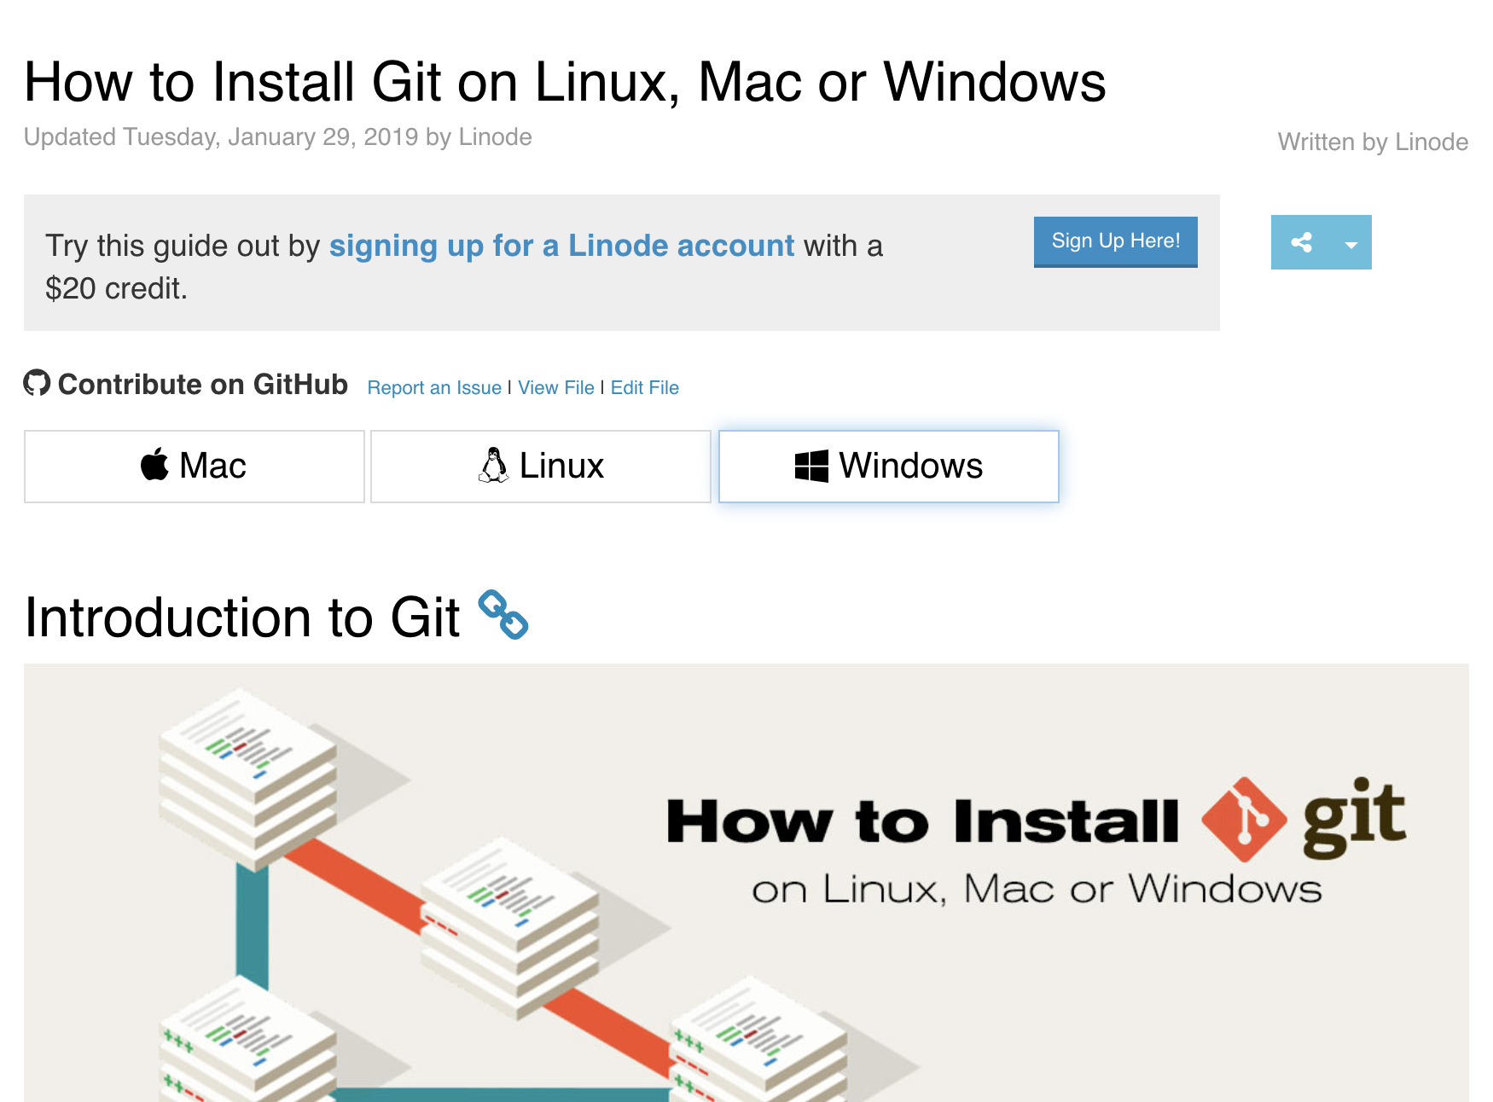
Git installation instructions
1. Go here:
https://www.linode.com/docs/development/version-control/how-to-install-git-on-linux-mac-and-windows/
2. Choose OS (Operating System)

Slide 7
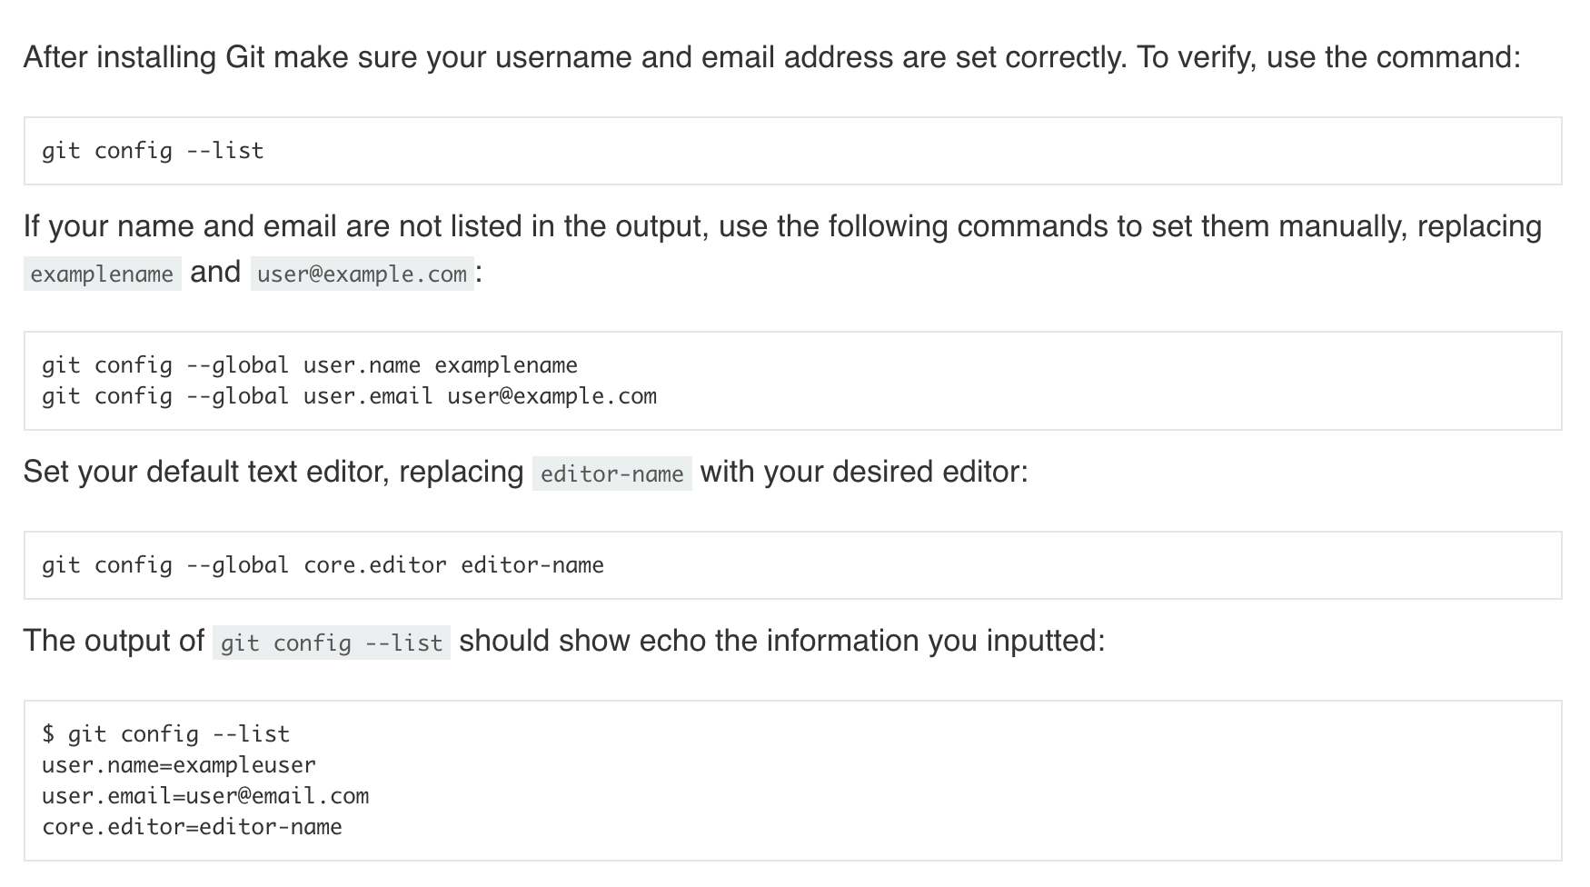
Configuring Git

Slide 8
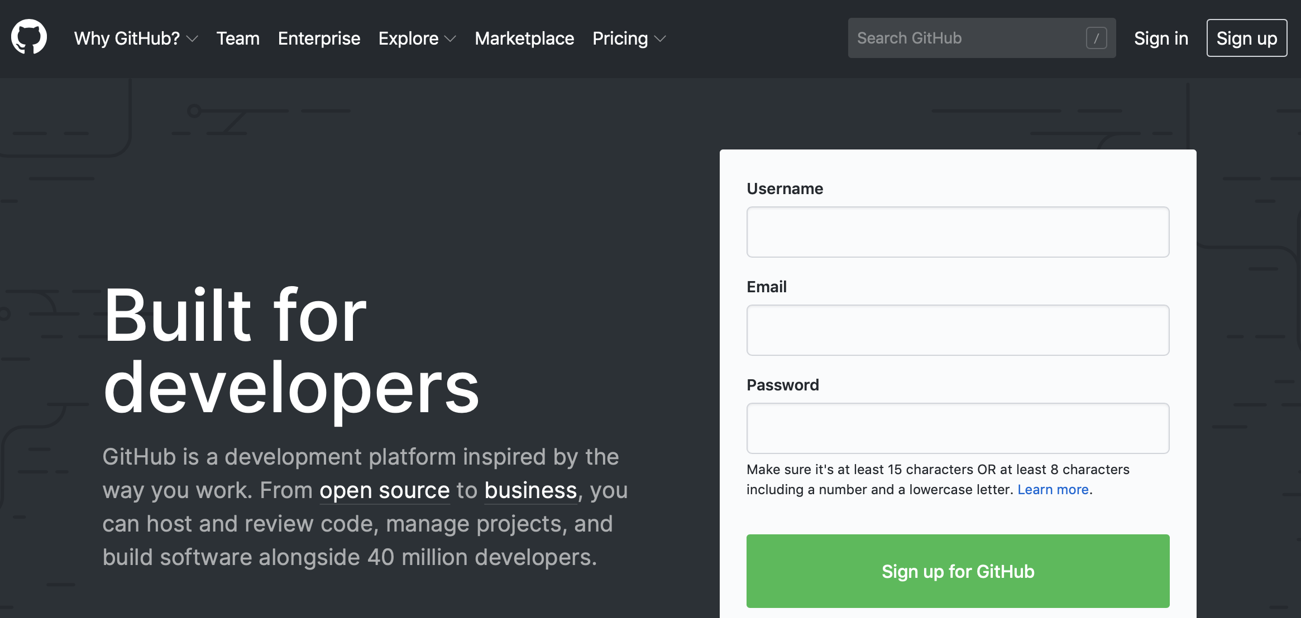
GitHub
GitHub is an online Git repository store
Commonly used to store and version control code
Repositories range from personal to enterprise
Some are public, some are private
Alternatives include BitBucket, SourceForge and AWS CodeCommit
Notes:
Go to www.github.com and Sign Up for an account

Slide 9
Basic Git Workflow 1
Step 1: Clone an existing remote repository
Step 2: Make changes to the code
Step 3: Push the changes to the remote repository
Step 4: Pull changes from remote repository

Slide 10



Step 1: Clone an existing remote repository
Git Basics
git clone https://github.com/IoC-Sunderland/git-basics.git
Git Basics

Slide 11

Steps 2 and 3: Make changes to the code/Push the changes to the remote repository
1
2
3
Git Basics
Git Basics
Git Basics
new_file is created…
git add new_file
Contents:
README.md
Contents:
README.md
new_file
Contents:
README.md
new_file
4
5
6
git commit -m ‘Added new_file’
Git Basics
Git Basics
git push
Contents:
README.md
new_file
Contents:
README.md
new_file
Notes:
Remote repository on GitHub contains a README.md file
A new file is added on local machine
This file is added to the staging area using git add (it is now tracked)
We now commit this change using the git commit -m command and push to GitHub using git push
Now both our local repo and remote repo are in sync

Slide 12
Step 4: Pull changes from remote repository
1
2
3
Git Basics
Git Basics
Git Basics
Add some text to
new_file on Github
Out of sync
Contents:
README.md
new_file
Contents:
README.md
new_file*
Contents:
README.md
new_file*
4
5
6
Git Basics
Git Basics
Git Basics
git pull
In sync
Contents:
README.md
new_file*
Contents:
README.md
new_file
Contents:
README.md
new_file
Notes:
Adding text to the new_file on GitHub means remote repo and local repo are out of sync
See 1
See 1
Moving to our local repo we issue a git pull
5 and 6. Now local repo and remote repo are in sync

Slide 13
Basic Git Workflow 2
Step 1: Initialise a new local folder as a Git repository
Step 2: Create a new file in that folder
Step 3: Go to GitHub and create a repo there with a similar name
Step 4: Follow GitHub instructions to add remote repo
Step 5: Add and commit file as in Basic Workflow 1
Step 6: Push file to remote repo using command:
git push -u origin master

Slide 14
Steps 1 and 2: Initialise a new local folder as a Git repository and add a new file to folder
1
2
Git_Example
Git_Example
Create a new empty
folder on your local
machine and call it:
Git_Example
Move into the
Git_Example folder
using the command line
Contents:
Contents:
3
4
5
Using the command line
check it has worked:
Git_Example
Using the command line type:
git init .
git status
Create a new file
in the folder and
call it new_file
Contents:
new_file

Slide 15
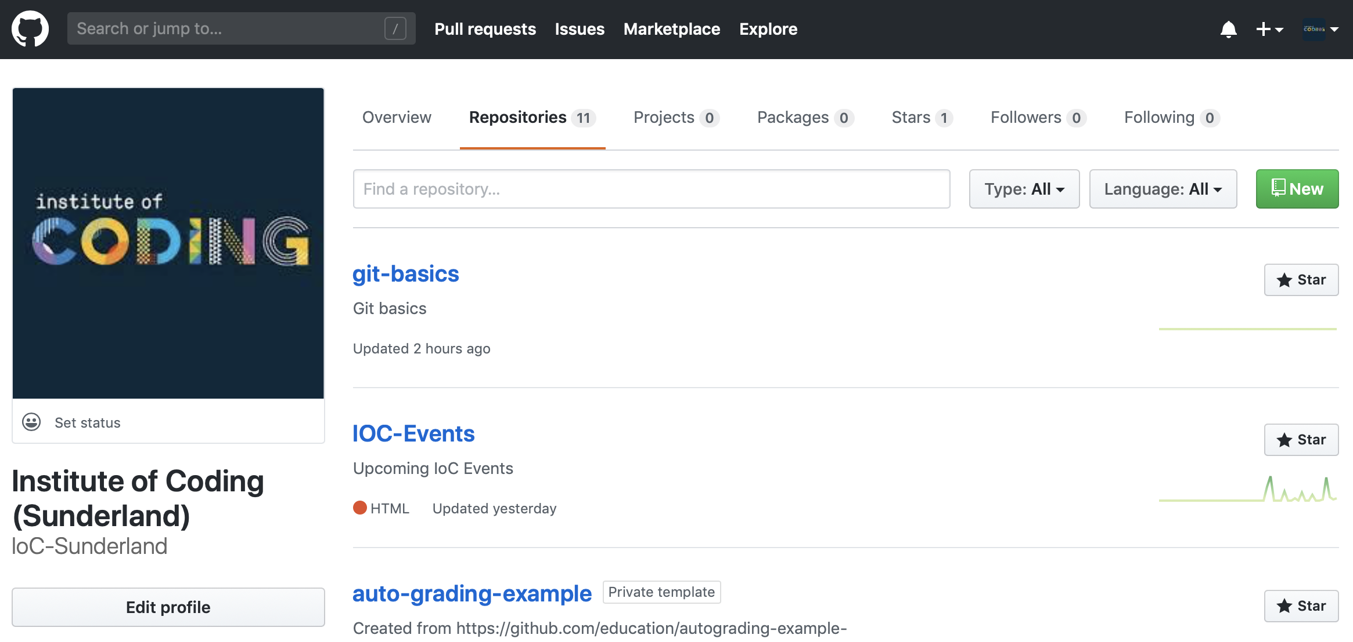
Step 3: Go to GitHub and create a repo there with a similar name

Slide 16
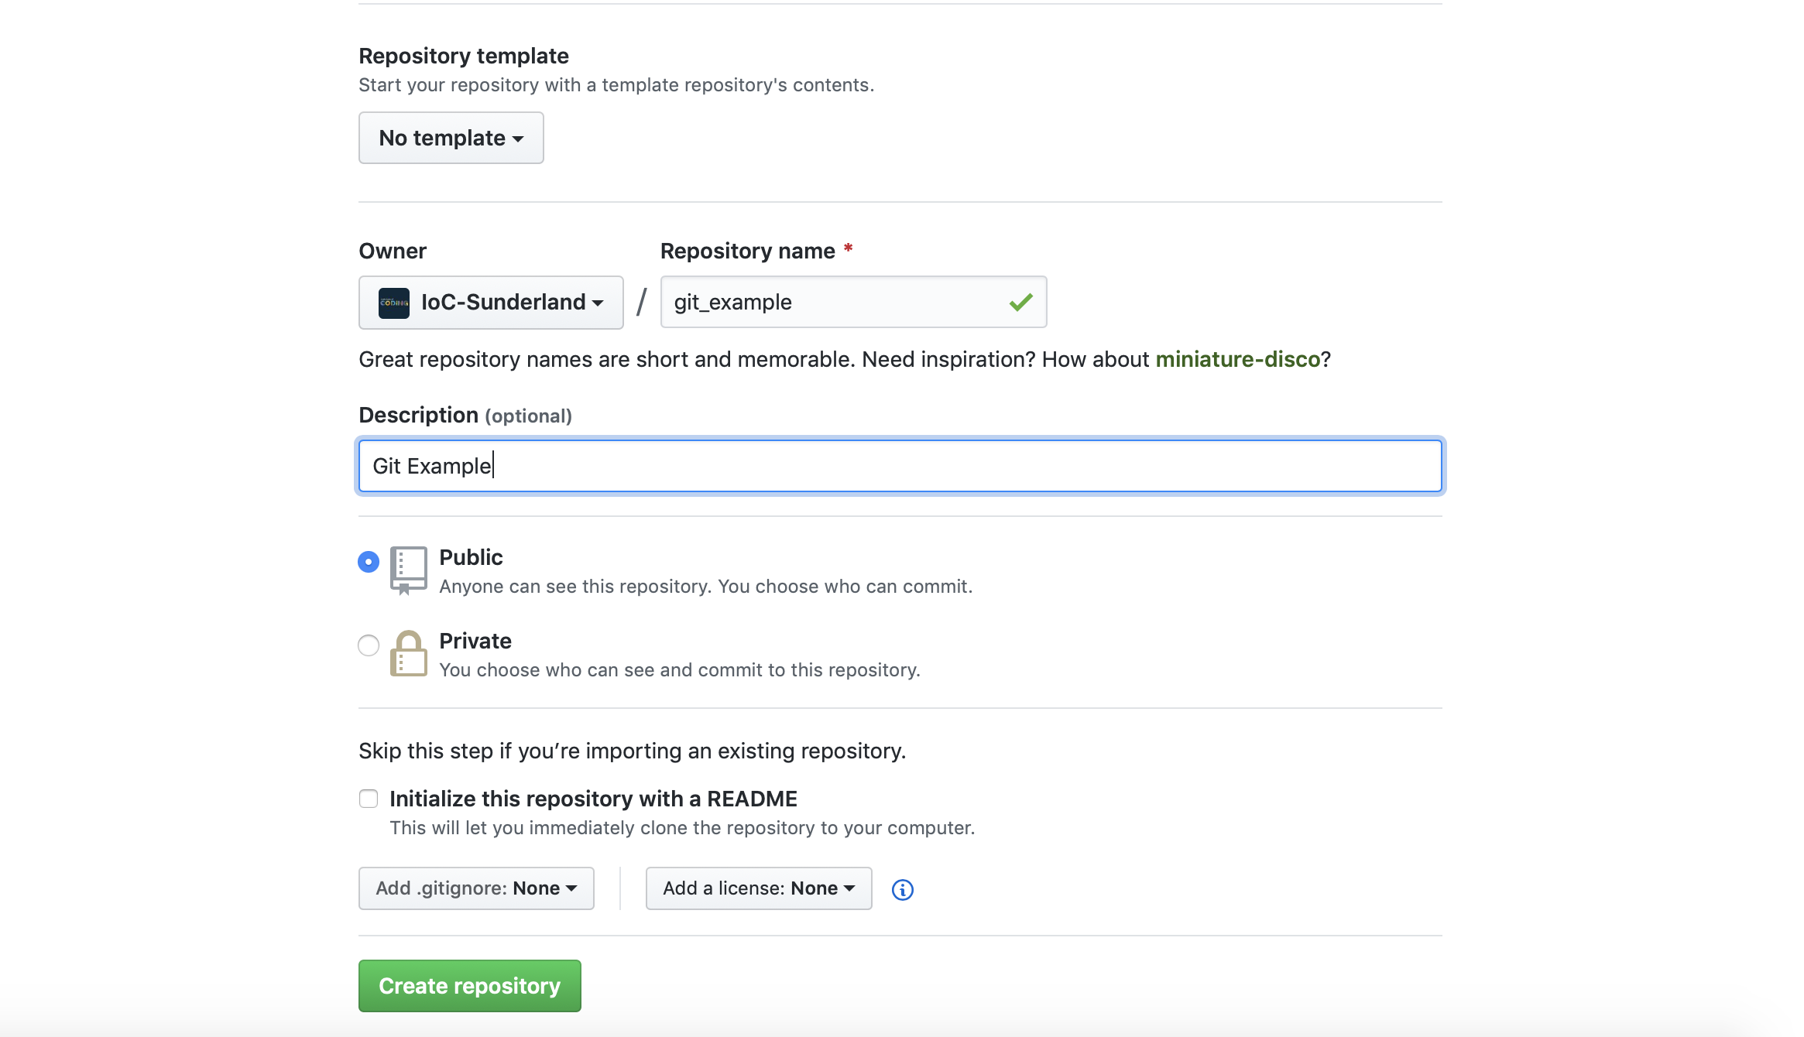
Step 3: Go to GitHub and create a repo there with a similar name
1
2
3
4
Notes:
Give repository the name git_example
Description is optional
Make this repo Public
Create the repo

Slide 17
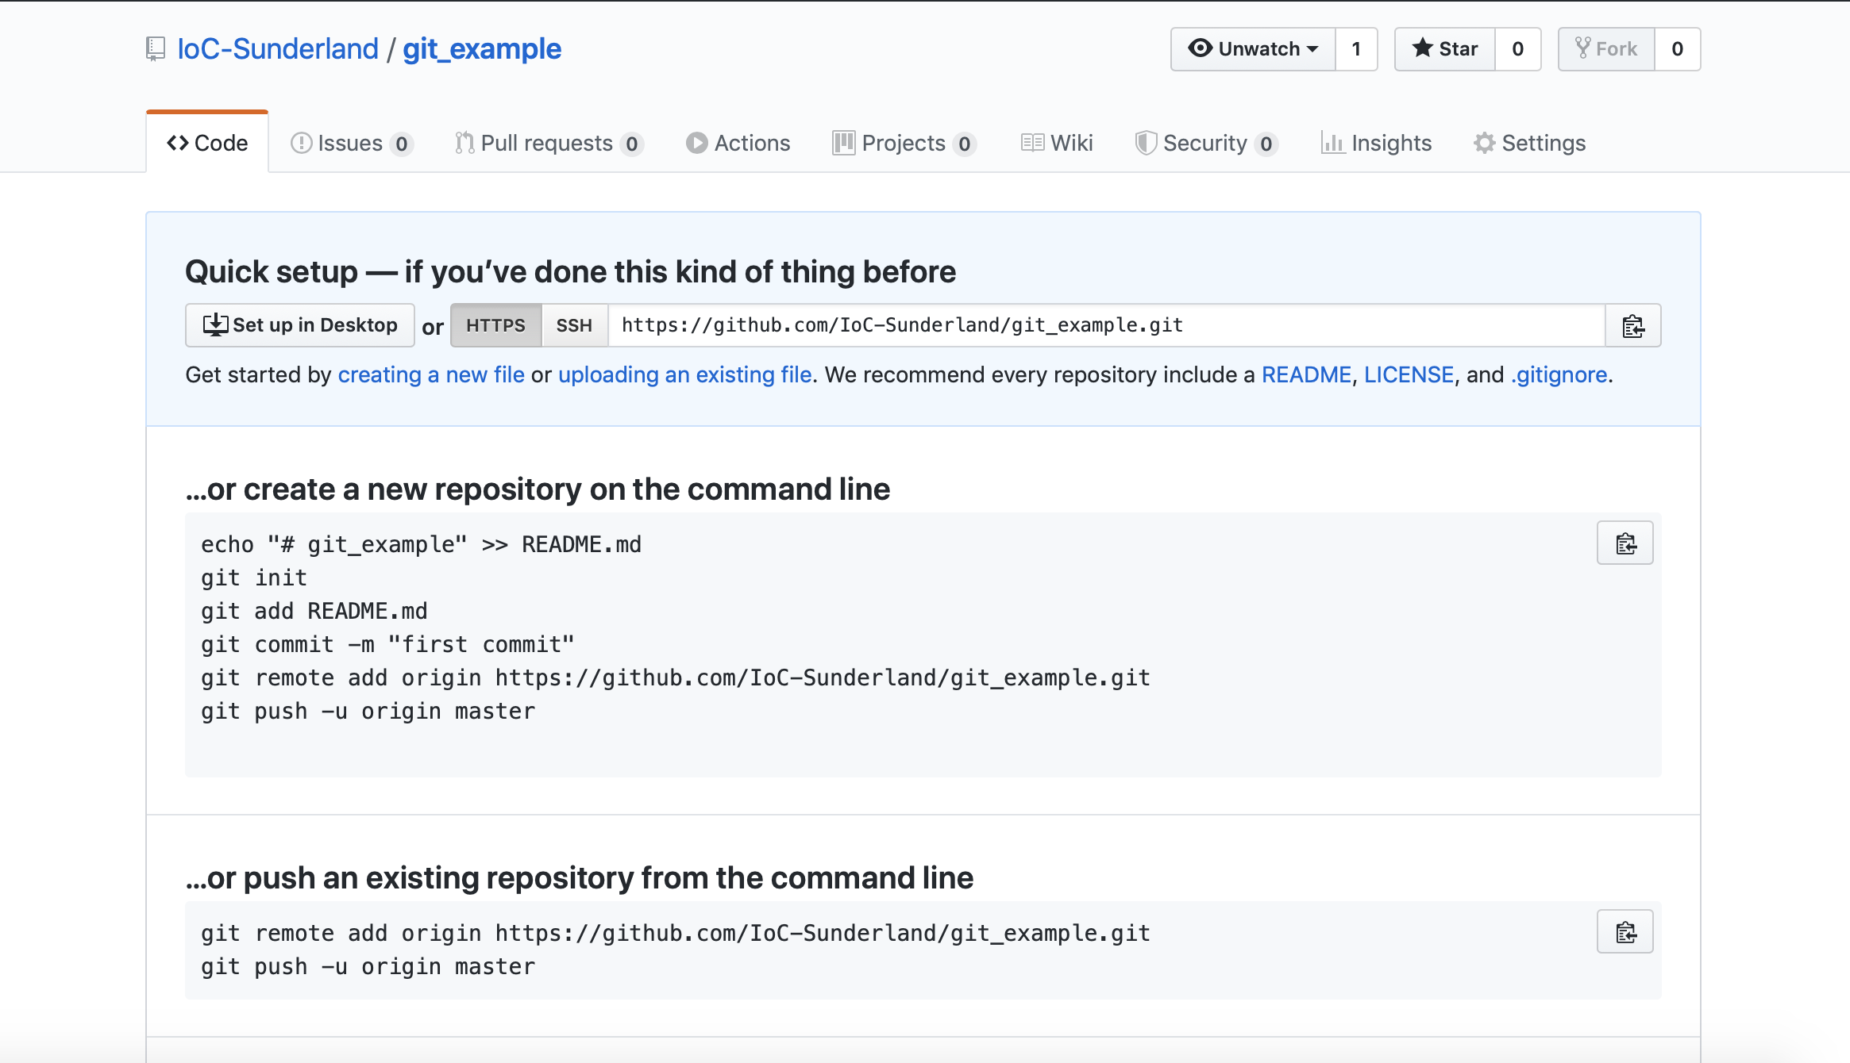
Step 4: Follow GitHub instructions to add remote repo
1
Notes:
You should see a screen like this once you hit Create Repository
We want to use the second option here because we already have an existing repository on our local machine: git_example
2. Copy and paste the first command into the command line:
git remote add origin https://github.com/IoC-Sunderland/git_example.git
Now when you add/amend files, commit, push and pull it will be to this remote repo on GitHub

Slide 18
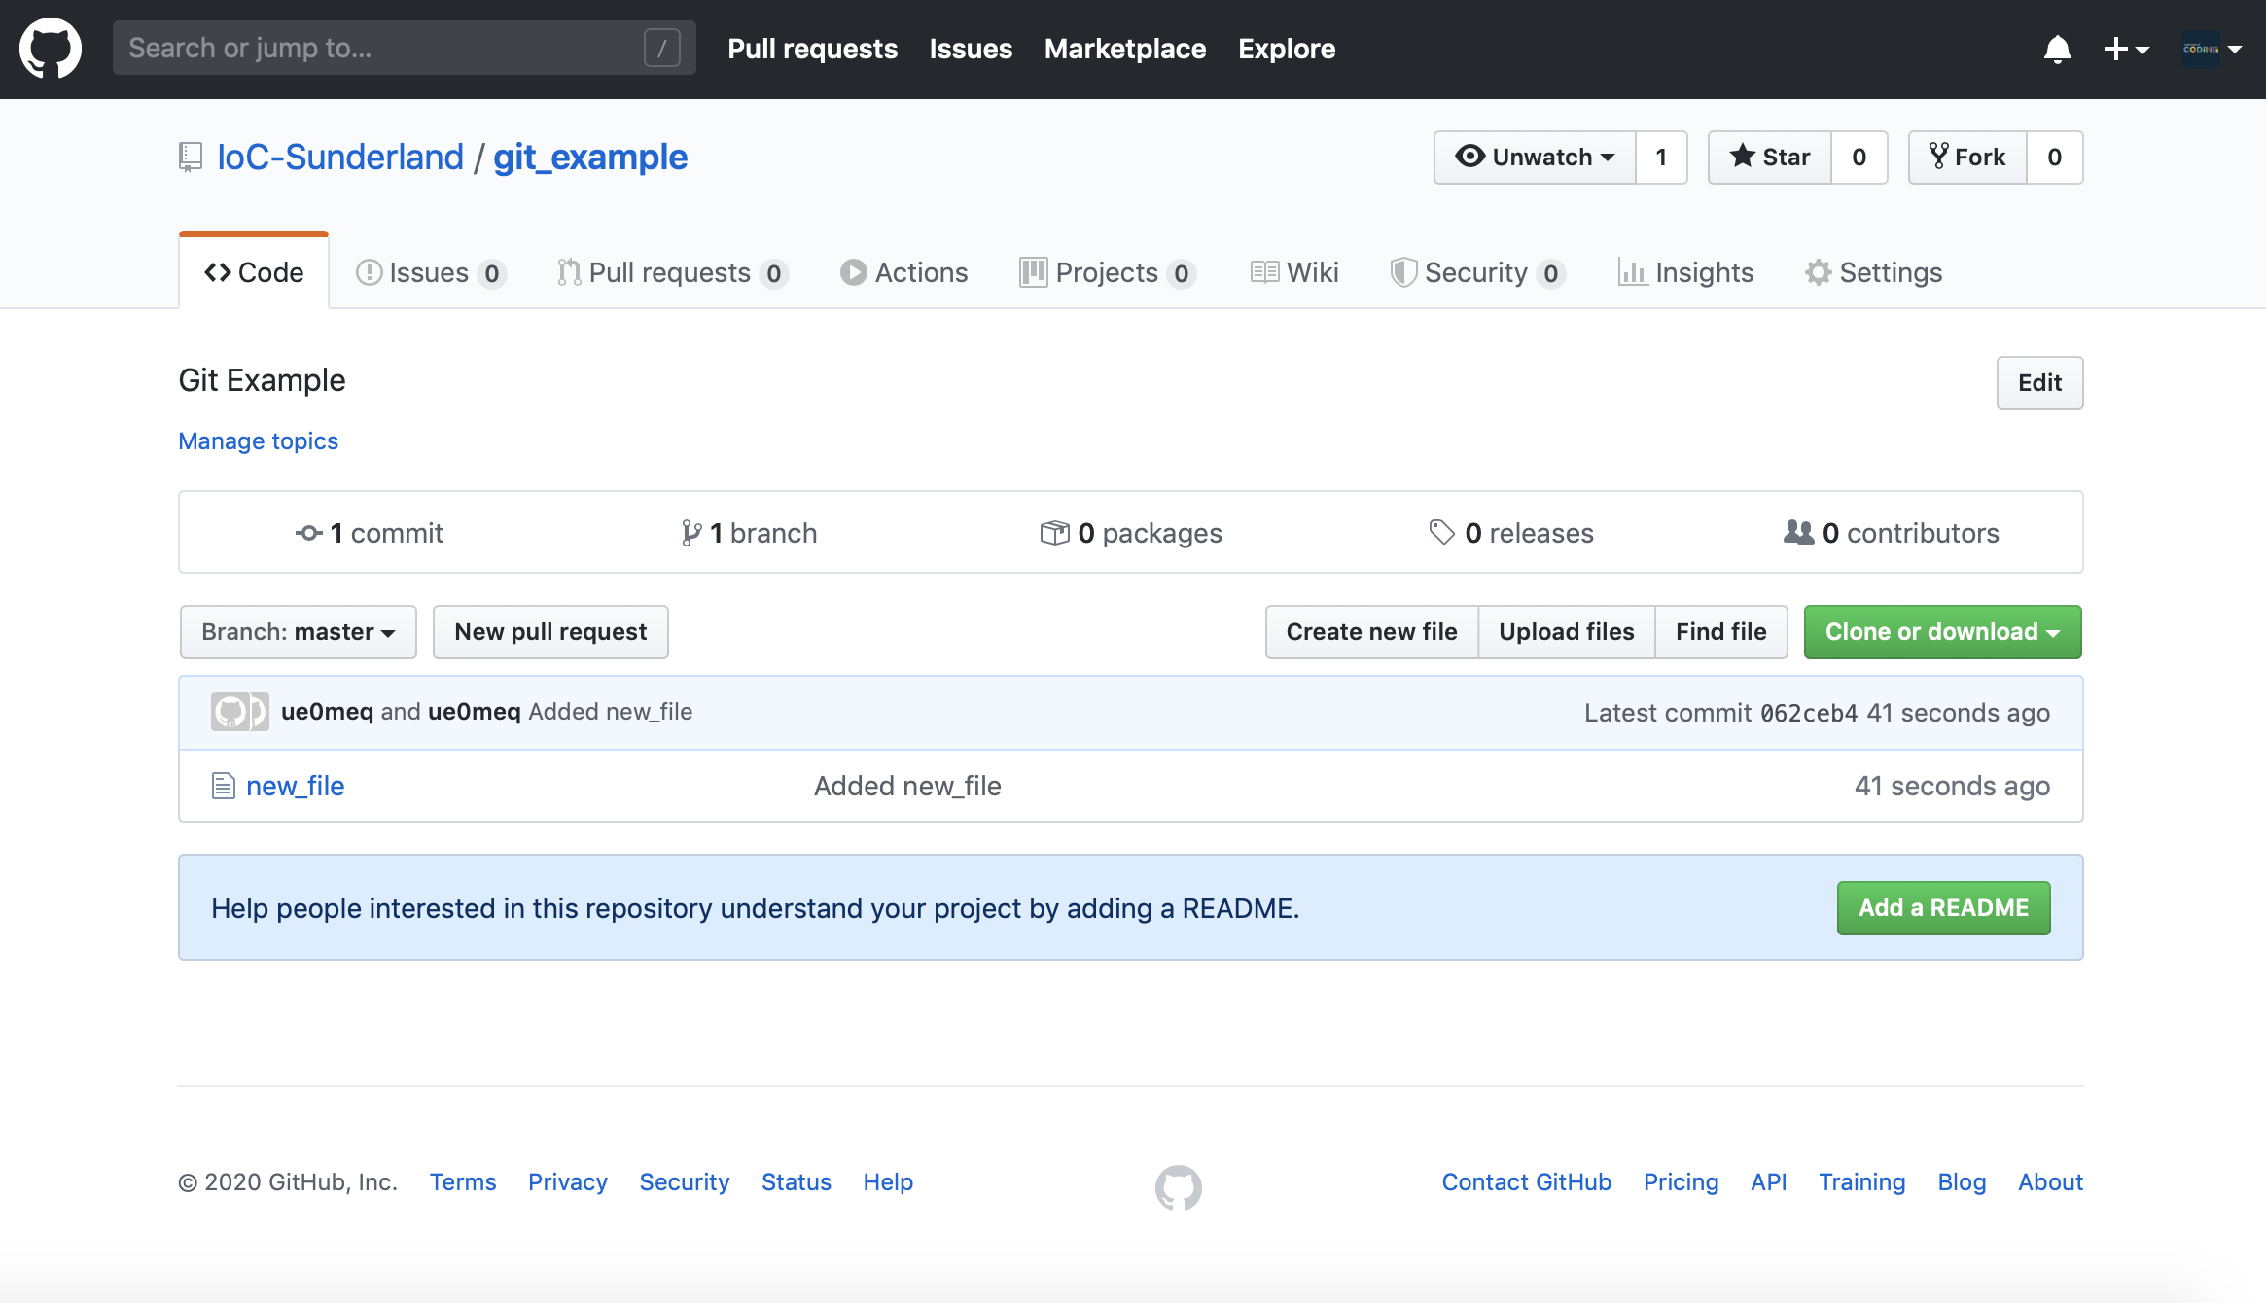
Step 5: Add and commit your file as in Basic Workflow 1 then push using command: git push -u origin master
1
Notes:
1. After a browser refresh, your local file should now be in your remote repo!

Slide 19
What did you learn
What is Git?
What is version control?
What is GitHub?
What are repositories?
Creating a Github account
Cloning repos
Adding files
Committing files
Git config
Push
Pull
Initialising a local repo

